Slide 1
First Realm database
Roger.wang

Slide 2
Outline
What is Realm database?
How to install
How to do CRUD – TapGame

Slide 3
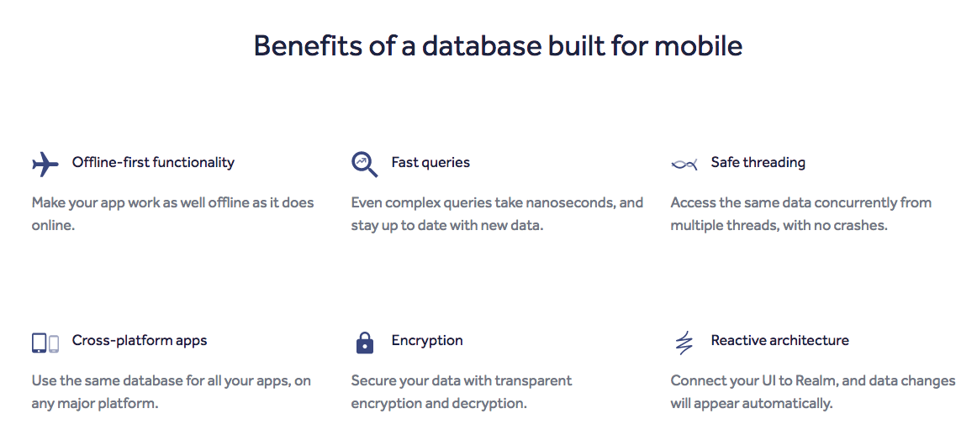
What is Realm database?
Is an alternative to SQLite and Core Data.

Slide 4
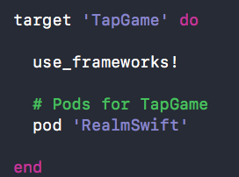
How to install?
Using CocoaPods
If your project uses Objective-C and Swift, changes 'RealmSwfit' to 'Realm'

Slide 5
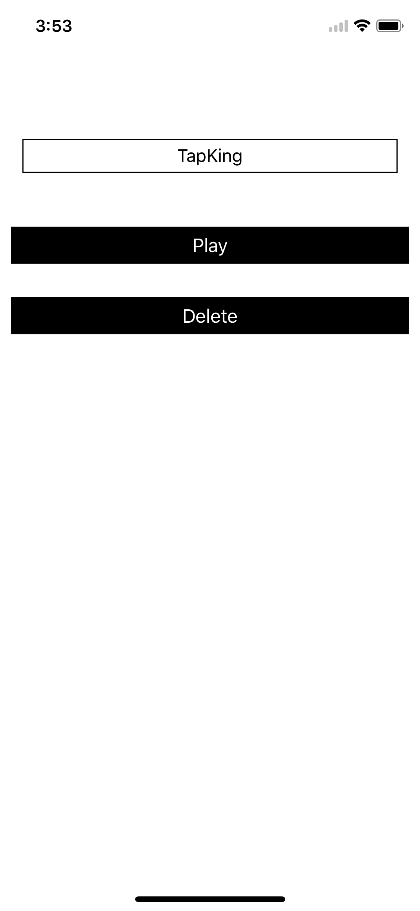
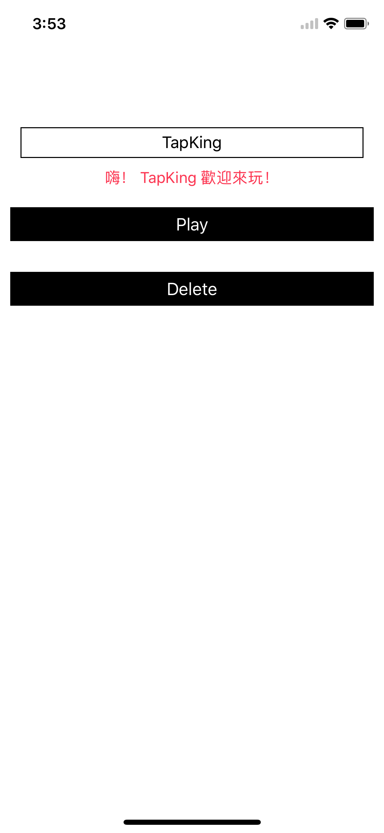

TapGame
We design a TapGame to demonstrate CRUD in Realm.

Slide 6
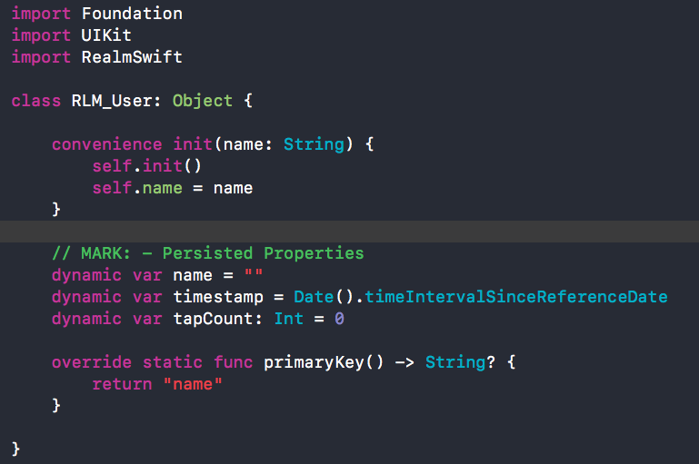
Design User Model

Slide 7
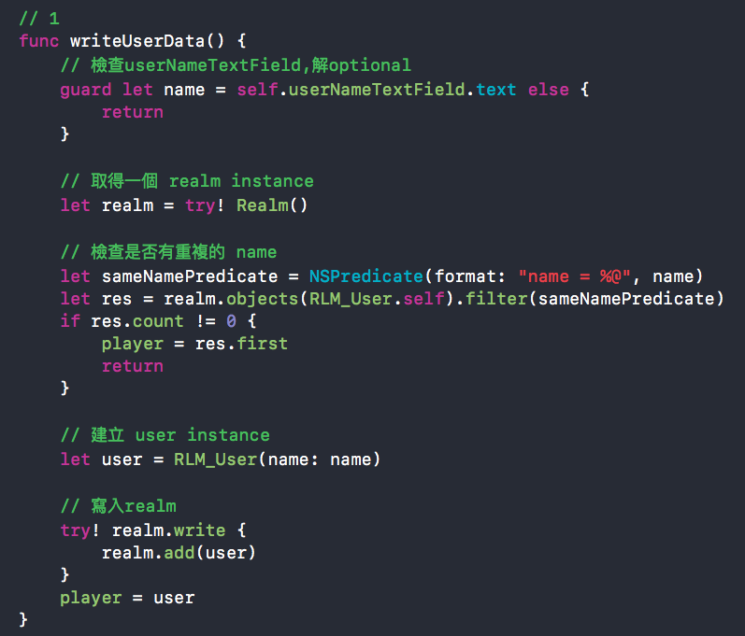
Create

Slide 8
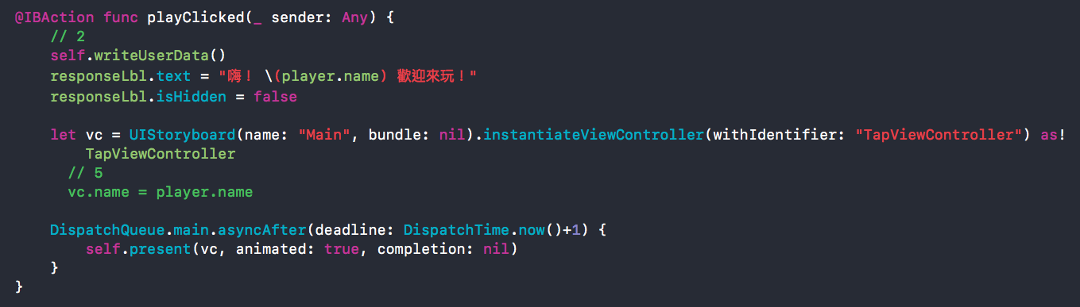
Create

Slide 9
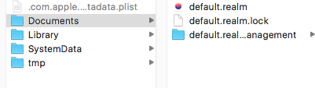
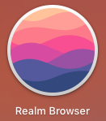
Create
Now run it, we can write user data in to realm database.
But where is the database?
How can we browse the database?
Use realm browser

Slide 10
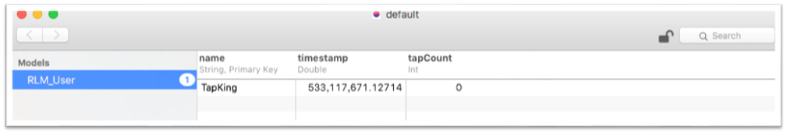
Realm Browser
Realm Browser can help us to monitor and modify value in database
For example, we can change tapCount to 10 runing app, then the tapCount will be 10.

Slide 11
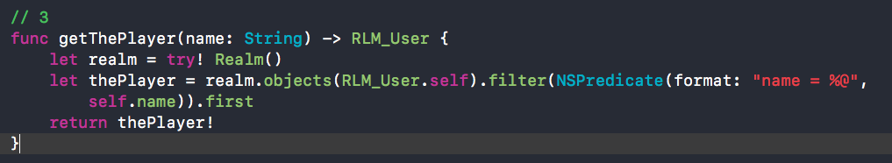
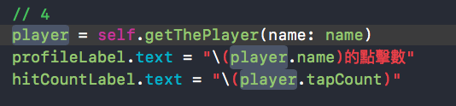
Read
New a function to get user data from realm in TapViewController.swift
Update UI using user data. Adding codes in viewDidLoad.

Slide 12


Read
TapViewController needs name to get user data from database. Back to viewcontroller.swift, Adding code in playClicked.
Run it, we can see the hitcount is 10 now.

Slide 13
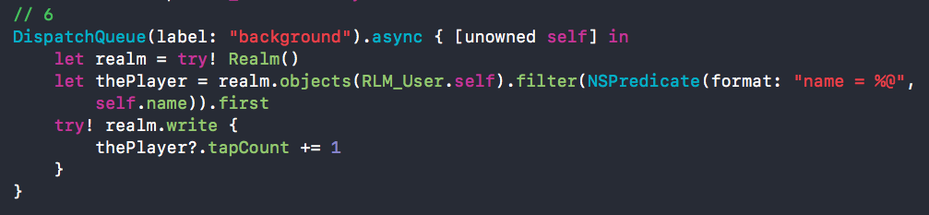
Update
We click the 'Hit it' button, the hitcount need be added one and be updated to database. Go to TapViewController.swift, adding code in hitUpdate.
Run app, and click button. Nothing happened, but go to the realm browser, the tapCount has been increase.

Slide 14
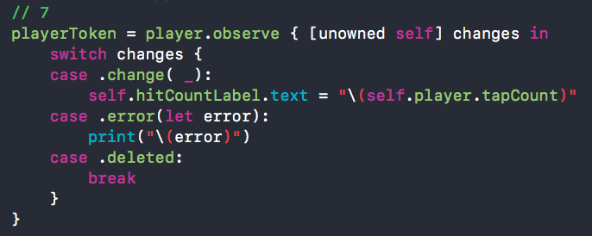

Observe
Realm proivde method to observe object changing. Adding code in viewWillAppear.
We need stop observe when view disappear. Adding code in viewWillDisappear. Run it and see what we got.

Slide 15
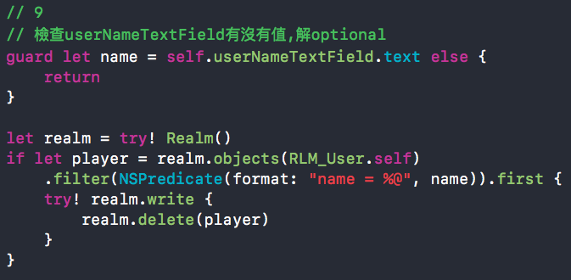
Delete
Back to ViewController.swif and finish the delete function. Adding code in deletecClicked.

Slide 16
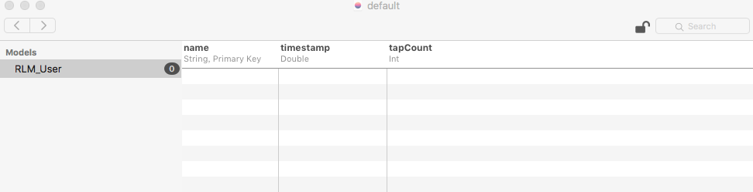
Delete
Run app and click the delete button. The user data should be deleted in realm database.

Slide 17
Ref.
https://ithelp.ithome.com.tw/articles/10183329
https://realm.io/cn/docs/swift/latest/#default-realm

